Slide 1
Food Insecurity in Indianapolis
Capstone Report
Kyle O’Brien

Slide 2
Introduction & Business Problem
Food insecurity affects 900,000+ Indiana Residents
280,000 Indianapolis residents live in a food desert
How can we identify neighborhoods effected?
Where should we fund food insecurity relief projects?

Slide 3
Data
Indianapolis zip codes with coordinates (csv)
https://indianapolis.areaconnect.com/zip2.htm?city=Indianapolis&search=zip
Geographical boundaries of each zip code (geojson)
https://data.indy.gov/datasets/bba987ced0cf4b7086650e3656b30d69_7

Slide 4
Data Continued
Foursquare location api
Allows searches for nearby venues, based off our desired settings
Proximity
Venue Category

Slide 5
Methodology
Read csv zip codes and corresponding latitude and longitude
Search for fresh food venues in each zip code using Foursquare api
Grocery store, organic food store, farmer’s market, or supermarket
Group venues within proximity of each zip code
Food desert is defined as exceeding a 1-mile radius in urban settings
Count total stores in each zip code
Create choropleth map to show density of stores by zip code

Slide 6
Results
13 out of 47 zip codes contain only 1 fresh food location
Outer regions of the metropolitan area
Max is 12 options in a single zip code
Highest density is downtown

Slide 7
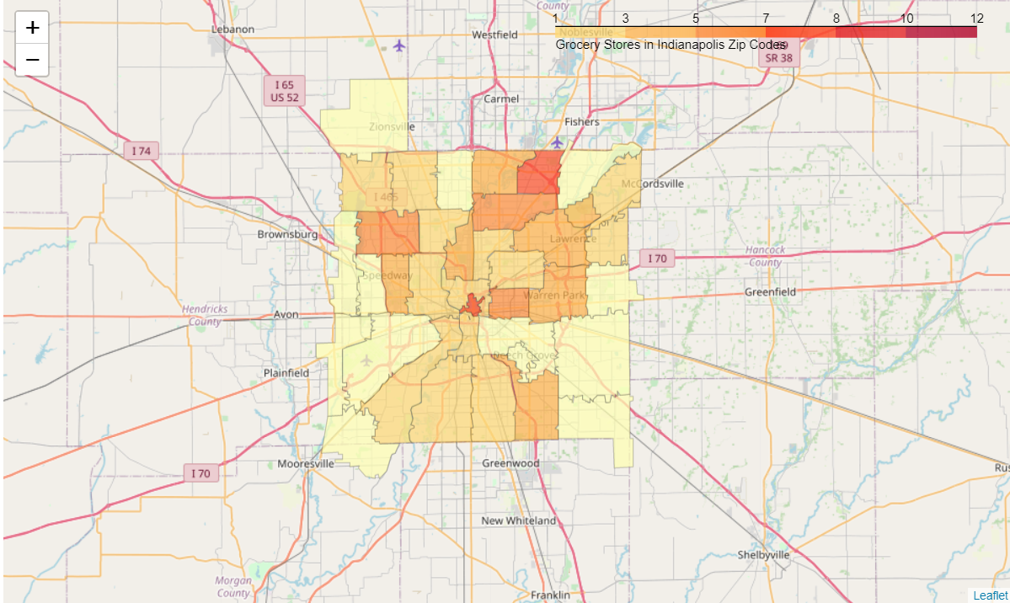
Results Continued – Choropleth Map

Slide 8
Discussion
Inequitable options for all residents
Largest benefit would be to serve the lowest density zip codes

Slide 9
Conclusion
Provides visual representation of neighborhoods within range of security
Next Steps:
Investigate population density
Look at resident health metrics
Other aids in decision-making for funding food projects

